Slide 1









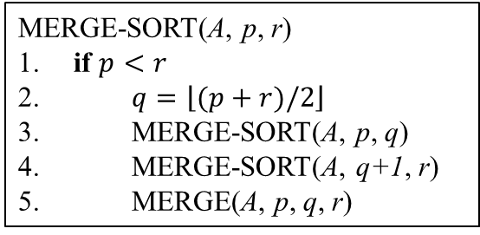
























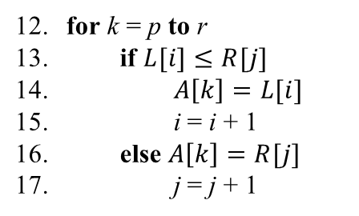





























Example
$$p$$
$$q$$
$$r$$
12 | 3 | 7 | 9 | 14 | 6 | 11 | 2
divide
$$p$$
$$q$$
$$1$$
$$r$$
$$11$$
$$p$$
$$q$$
$$r$$
Merge-sort procedure
12 | 3 | 7 | 9
14 | 6 | 11 | 2
MERGE-SORT(A, p, r)
if $p<r$
$q=\left\lfloor (p+r)/2\right\rfloor$
MERGE-SORT(A, p, q)
MERGE-SORT(A, q+1, r)
MERGE(A, p, q, r)
divide
$$p$$
$$2$$
$$p$$
$$6$$
$$p$$
$$12$$
$$p$$
$$16$$
$$q$$
$$r$$
$$q$$
$$r$$
$$q$$
$$r$$
$$q$$
$$r$$
12 | 3
7 | 9
14 | 6
11 | 2
divide
$$3$$
$$4$$
7
8
$$13$$
$$14$$
17
18
$$p,r$$
$$p,r$$
$$p,r$$
$$p,r$$
$$p,r$$
$$p,r$$
$$p,r$$
$$p,r$$
12
3
7
9
14
6
11
2
MERGE(A, p, q, r)
……
merge
$$5$$
9
$$15$$
19
$$p$$
$$q$$
$$r$$
$$p$$
$$q$$
$$r$$
$$p$$
$$q$$
$$r$$
$$p$$
$$q$$
$$r$$
3 | 12
7 | 9
6 | 14
2 | 11
for k = p to r
if $L[i]≤R[j]$
$A\left[k\right]=L[i]$
i = i + 1
else $A\left[k\right]=R[j]$
j = j + 1
merge
10
20
$$p$$
$$q$$
$$r$$
$$p$$
$$q$$
$$r$$
3 | 7 | 9 | 12
2 | 6 | 11 | 14
merge
21
$$p$$
$$q$$
$$r$$
2 | 3 | 6 | 7 | 9 | 11 | 12 | 14

